Slide 1


Mining Billions of AST Nodes to Study Actual and Potential Usage of Java Language Features Review
Weiting Ye

Slide 2


Java features changes how people use Java
Studying current and potential usage of Java Language Features:
Means
How to analyze
What to improve

Slide 3
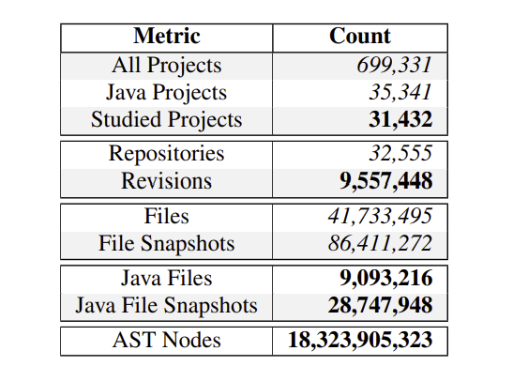
Means
Dataset used for the article study is the September 2013 dataset from Boa.

Slide 4
Introduction to Boa
Boa is a domain-specific language and infrastructure that eases mining software repositories. Boa's infrastructure leverages distributed computing techniques to execute queries against hundreds of thousands of software projects very efficiently.
Created by Iowa State University of Science and Technology
Example uses:
Covid19: Boa for COVID-19 can help with solving the COVID-19 problem by analyzing text for COVID-19 papers.
Genomics: BoaG, a cyber infrastructure for analyzing genomics data.

Slide 5
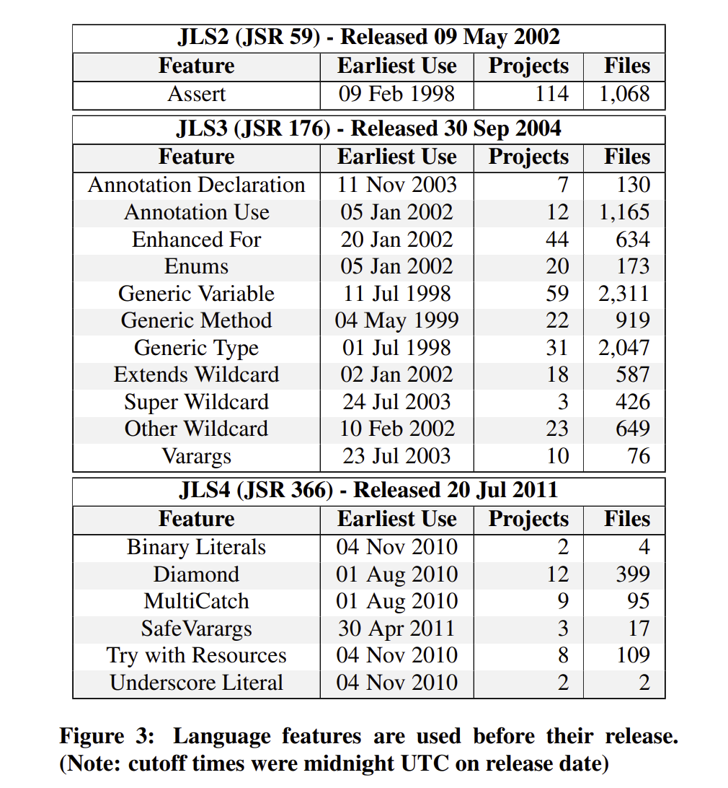
Analyze
Filtered out any particular feature based on the particular language feature’s release date.

Slide 6
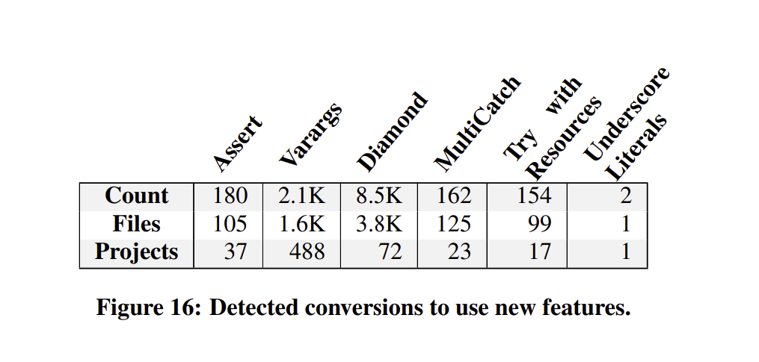
Improve
There is also room for improvement in IDEs. Not all features are enabled out of the box, some features may be slightly and not all features have conversions or recommendations.

Slide 7
How new Java language features been changing the Java use?
Adding additional features
Simplifying common tasks
Community driven need

Slide 8
How to define Java language?
Java Language Specifications (JLS)

Slide 9
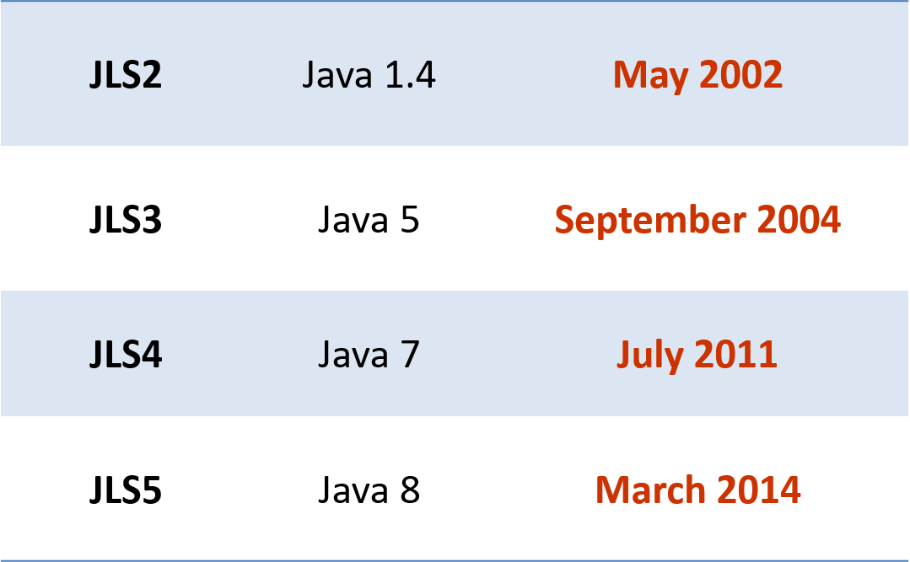
Java Language Specifications (JLS)
JLS in different gens
JLS2
JLS3
JLS4
JLS5

Slide 10
Questions in the article:
Are language features used before release?
How frequently was each language feature used?
Some features are more popular than others. Why?
How did committers adopt features?
Could features have been used more?

Slide 11
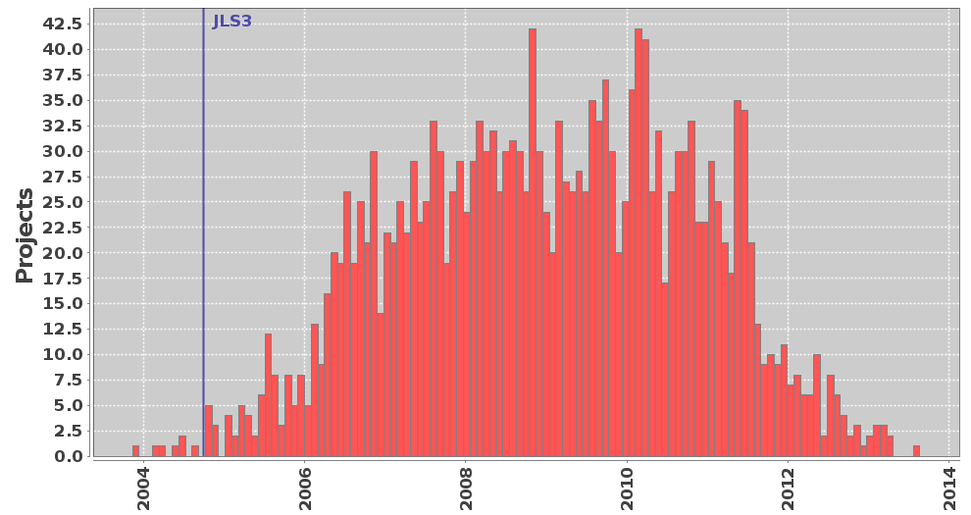
Are language features used before release?
Most language feature are in beta test before it release to the general platform.

Slide 12

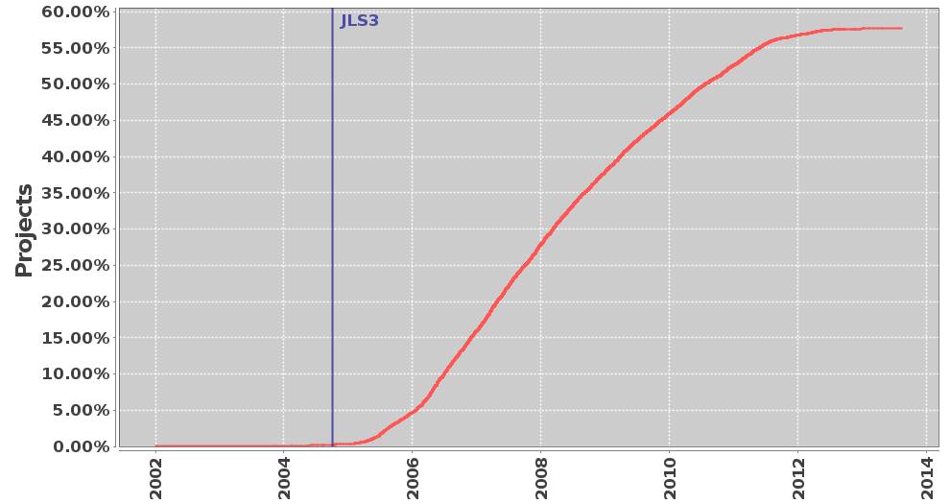
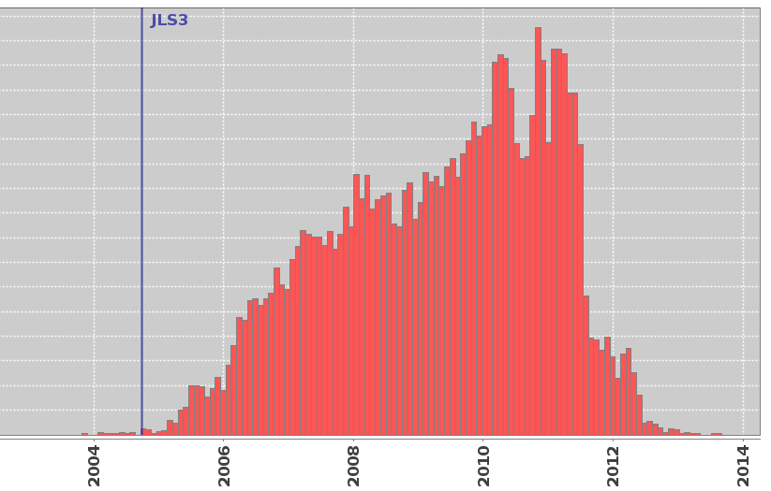
How frequently was each language feature used?
The use general a graduate increase till it reach the top spike, then abandon if more effective features appears.
Project Density: Annotation Use
Project Histogram: Annotation Use

Slide 13
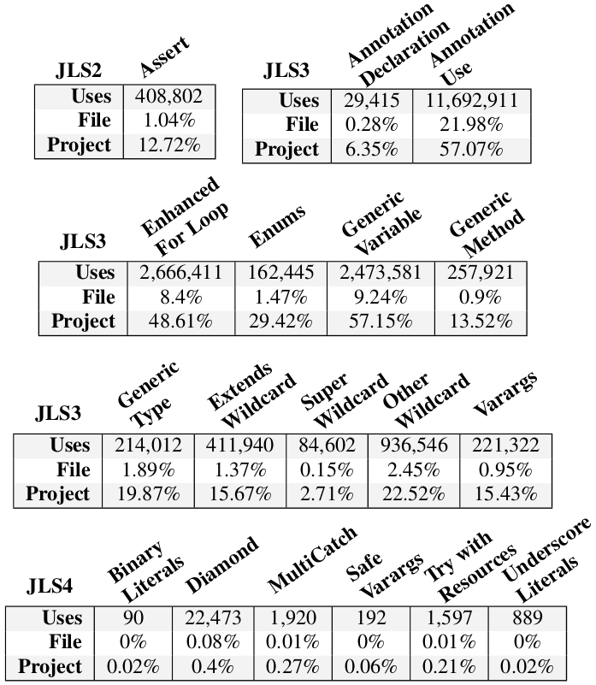
Some features are more popular than others.

Slide 14
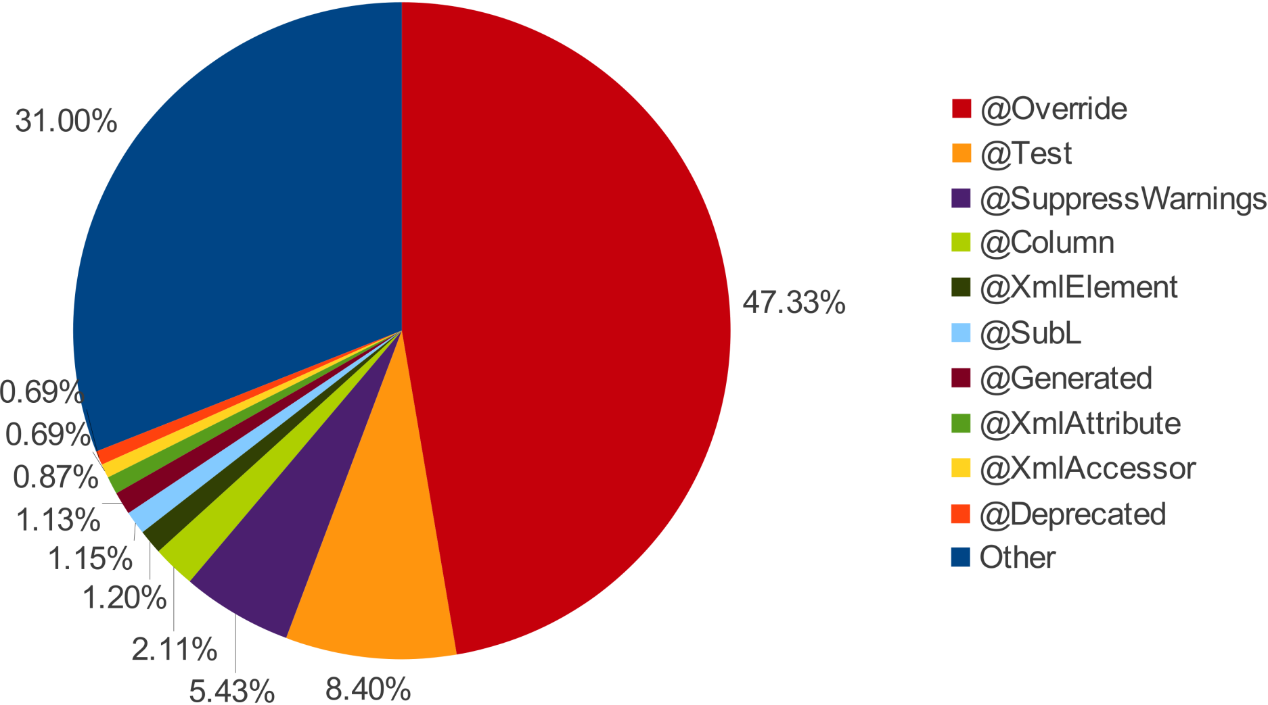

Slide 15
Popular Features:
List
ArrayList
Map
HashMap
Set
Collection
Vector
Class
Iterator
HashSet

Slide 16
How did committers adopt features?
Adoption by individuals, not teams
(confirms [Parnin et al. MSR'11])

Slide 17
Could features have been used more?
Impact: Potential for bugs
Mine for methods that:
1. declare they throw IOException
2. do not catch IOException in body
3. contain a call to close()

Slide 18

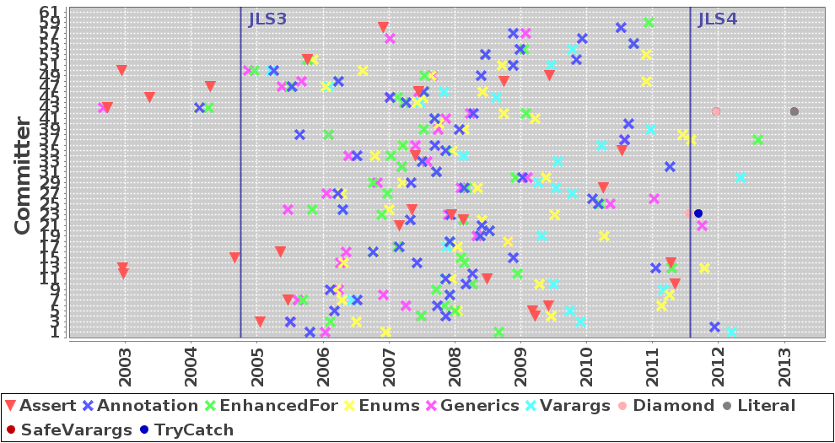
Future adoption trend?
Similar usage patterns
Individuals committers uses pattern

Slide 19
Summary
New features are essential to keep the language alive. Comprehensive features will be adoption and updated over time.

Slide 20
Any questions?

Slide 21
Citations:
Mining billions of AST nodes to study actual and potential usage of Java language features, 2014, Accessed on: June 2, 2021. [Online]. Available: https://dl.acm.org/doi/pdf/10.1145/2568225.2568295

